Slide 1
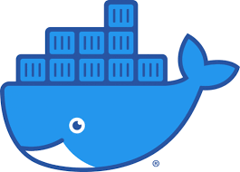
Docker
Containerization platform
DATE
2nd July 2021

Slide 2
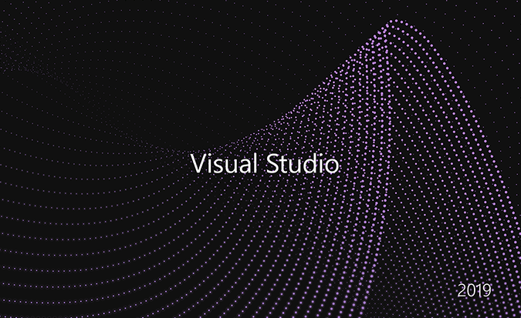
Prerequisites
Visual Studio 2019 with C# and dot net core
And Docker Desktop

Slide 3
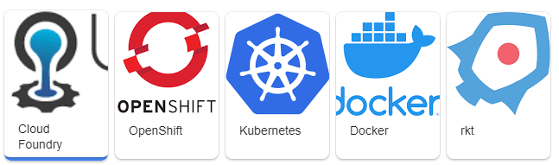
Containers
What is this Container-thing developers are talking about. And why should you use it? In this module you will get an overview of what containers are, and how to use them on and with Windows and Linux.
Why Containers?
Containers vs Virtual Machines
Linux, Windows and Hyper-V Containers
Container Orchestration

Slide 4
What is Docker?
Docker is a containerization platform used to develop, ship, and run containers. Docker doesn't use a hypervisor, and you can run Docker on your desktop or laptop if you're developing and testing applications. The desktop version of Docker supports Linux, Windows, and macOS. For production systems, Docker is available for server environments, including many variants of Linux and Microsoft Windows Server 2016 and above. Many clouds, including Azure, supports Docker.
What is a container?
A container is a loosely isolated environment that allows us to build and run software packages. These software packages include the code and all dependencies to run applications quickly and reliably on any computing environment. We call these packages container images.
The container image becomes the unit we use to distribute our applications.

Slide 5

Docker basics
Containerized applications
Docker is a containerization platform to build and deploy containers
Infrastructure
Operating system
Docker
Application 1
Application 2
Application 3
Application 4
Application 5

Slide 6
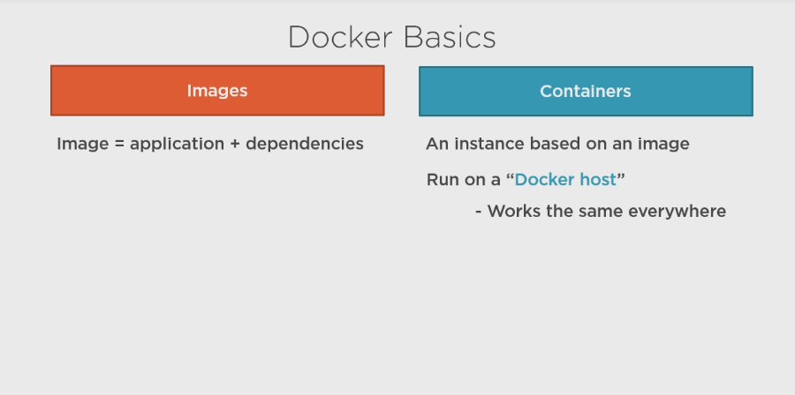

Slide 7
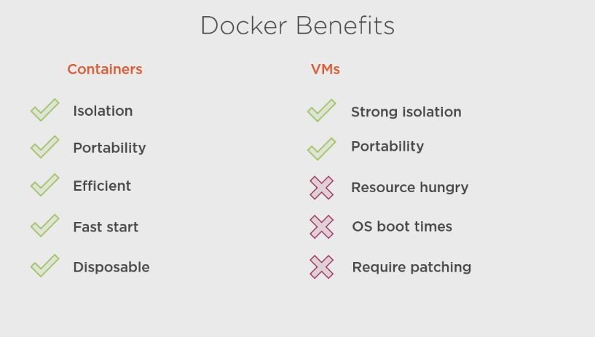

Slide 8
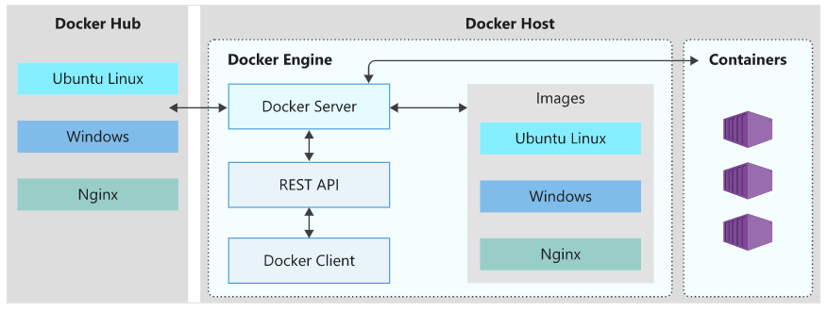
Docker architecture

Slide 9
The Docker client
The Docker client is a command-line application named docker that provides us with a command line interface (CLI) to interact with a Docker server. The docker command uses the Docker REST API to send instructions to either a local or remote server and functions as the primary interface we use to manage our containers.
The Docker server
The Docker server is a daemon named dockerd. The dockerd daemon responds to requests from the client via the Docker REST API and can interact with other daemons. The Docker server is also responsible for tracking the lifecycle of our containers.
Docker objects
There are several objects that you'll create and configure to support your container deployments. These include networks, storage volumes, plugins, and other service objects. We won't cover all of these objects here, but it's good to keep in mind that these objects are items that we can create and deploy as needed.
Docker Hub
Docker Hub is a Software-as-a-Service (SaaS) Docker container registry. Docker registries are repositories that we use to store and distribute the container images we create. Docker Hub is the default public registry Docker uses for image management.

Slide 10
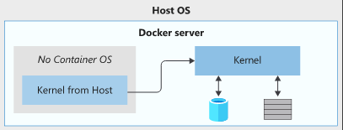
What is the host OS?
The host OS is the OS on which the Docker engine runs. Docker containers running on Linux share the host OS kernel and don't require a container OS as long as the binary can access the OS kernel directly.
Diagram showing a Docker image with no base OS and the dependency on the host OS Kernel.
However, Windows containers need a container OS. The container depends on the OS kernel to manage services such as the file system, network management, process scheduling, and memory management.

Slide 11
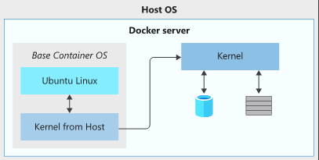
What is the container OS?
The container OS is the OS that is part of the packaged image. We have the flexibility to include different versions of Linux or Windows OSs in a container. This flexibility allows us to access specific OS features or install additional software our applications may use.
Diagram showing a Docker image with an Ubuntu base OS and the dependency on the host OS Kernel.
The container OS is isolated from the host OS and is the environment in which we deploy and run our application. Combined with the image's immutability, this isolation means the environment for our application running in development is the same as in production.

Slide 12
Now in real business applications we actually needs multiple containers to host our application in distributed environment across multiple clustered servers especially when we are using architecture like microservices.
Which introduces number of challenges like..

Slide 13
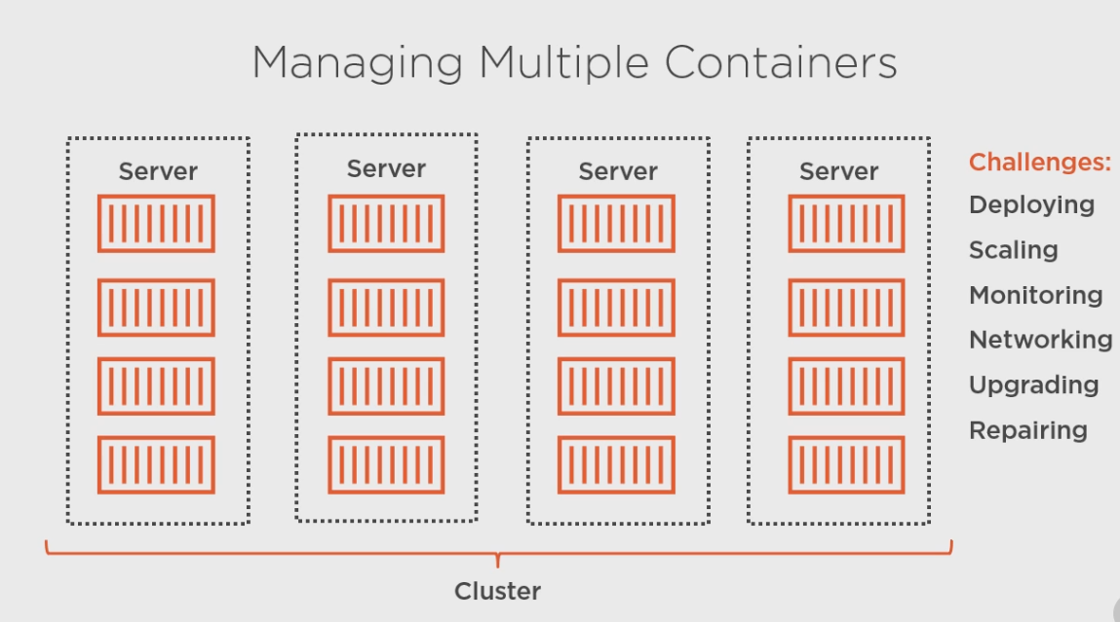

Slide 14
To handle these challenges orchestrator is coming in to the picture which will configure multiple nodes based on your clustered server requirements using YAML files
Some of the useful orchestrators are
Kubernetes
Service Fabric

Slide 15
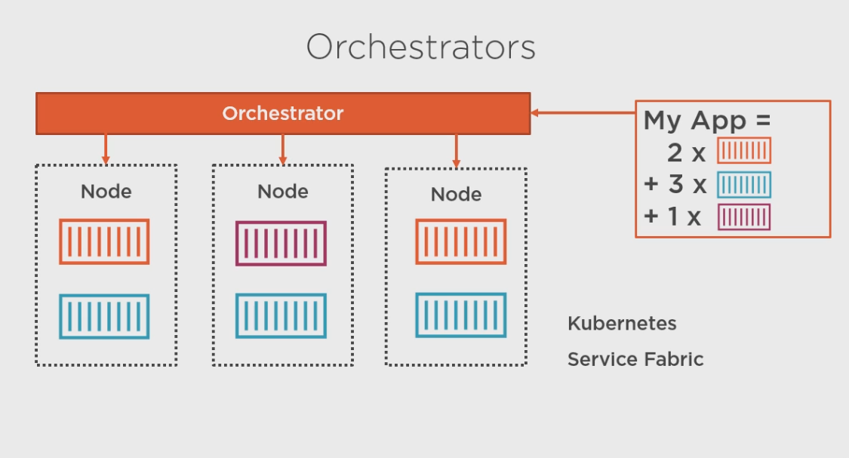

OpenShift
Kubernetes
Service Fabric

Slide 16
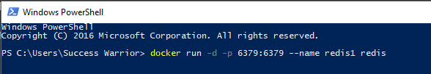
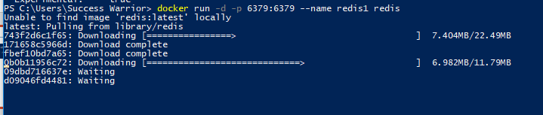
detach
Publish port host:container
Containername imagetag
docker run -d -p 6379:6379 --name redis1 redis

Slide 17
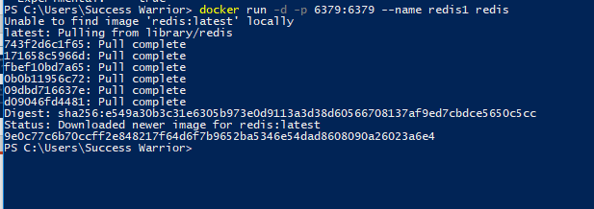
This is ID of newly created container

Slide 18
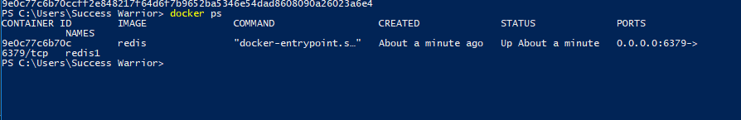
You can run docker ps command to see
What containers are running currently

Slide 19

This will give you list of docker images stored locally

Slide 20
Now I want to execute my container with shell
In interactive mode for my redis image which
We have created

Slide 21

Interactive
shell
docker exec -it redis1 sh
Fire this command and you will enter in shell
With #

Slide 22
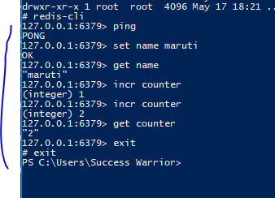

Slide 23

To stop any container
So now docker ps is not showing anything

Slide 24

This will show you that container and you can see
Its not running from status of it

Slide 25
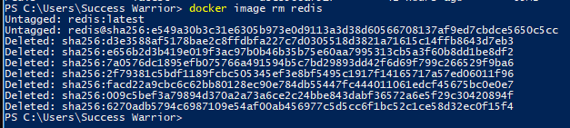

Slide 26
Docker version
Docker run
Docker ps
Docker images docker image ls
Docker ps –a
Docker stop
Docker rm
Docker image rm

Slide 27
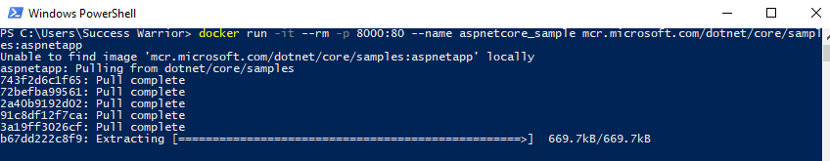
docker run -it --rm -p 8000:80 --name aspnetcore_sample mcr.microsoft.com/dotnet/core/samples:aspnetapp

Slide 28
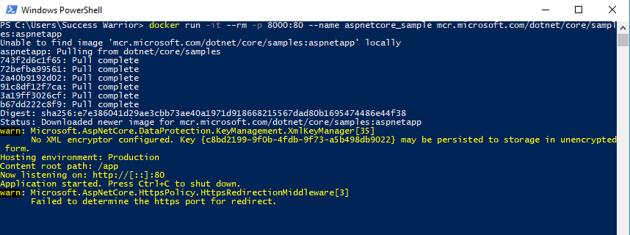

Slide 29
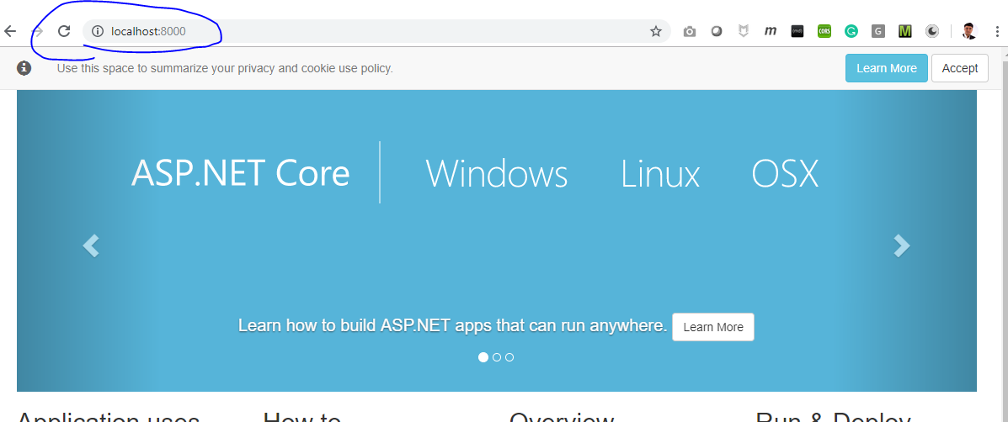

Slide 30
Docker images
Docker run
Docker ps
Docker images
Docker exec
Docker stop
Docker ps –a
Docker rm
Docker image rm

